Slide 1

Artificial Intelligence & Machine learning
For RNATE 2k22
By Sandesh Gajendra Pol

Slide 2

Point to be discussed
What is Artificial Intelligence
What is Machine Learning
Working
Application and Case study
on AI & ML
Conclusion

Slide 3
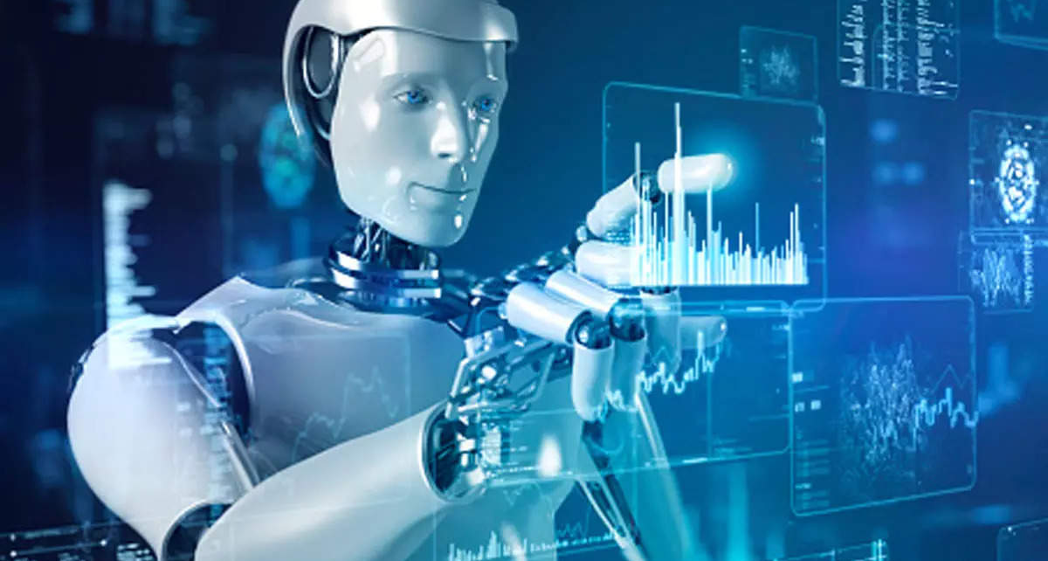
What is Artificial Intelligence
AI is the ability of the machines or computer program To carry out tasks that requires human beings to use their intelligence
Artificial intelligence is the ability of a computer program or a machine to think and learn.
AI research really started with a conference at Dartmouth College in 1956.
The teams Machine Learning and Deep Learning is sub set of Artificial Intelligence

Slide 4
Major Artificial Intelligence techniques
Rules and logic base approach
Machine learning based approach
Hybrid system

Slide 5

What is Machine learning
In field of computer science, Gives computers the ability to learn without being explicitly programmed
A technique that allows computer to learn
It make computer able to predict
Basic premise is built algorithms that they can receive input data and use statistical analysis to predict an output values
It is type of AI that allows application to become more accurate in predict
It first time appears in 1956

Slide 6
Types of Machine learning algorithms
Supervised learning
Unsupervised learning
Semi supervised learning
Reinforcement learning

Slide 7
Working of Machine learning
Input Data
Analyze Data
Find Patterns
Prediction
Stores the feedback

Slide 8
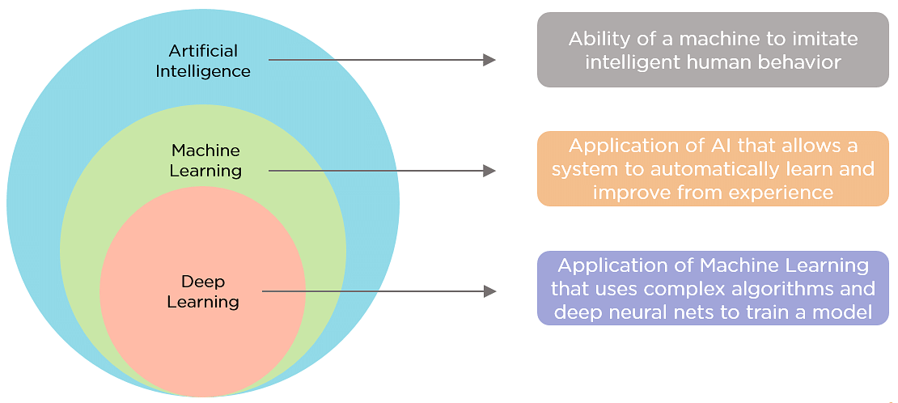
Relation between Artificial Intelligence & Machine learning

Slide 9
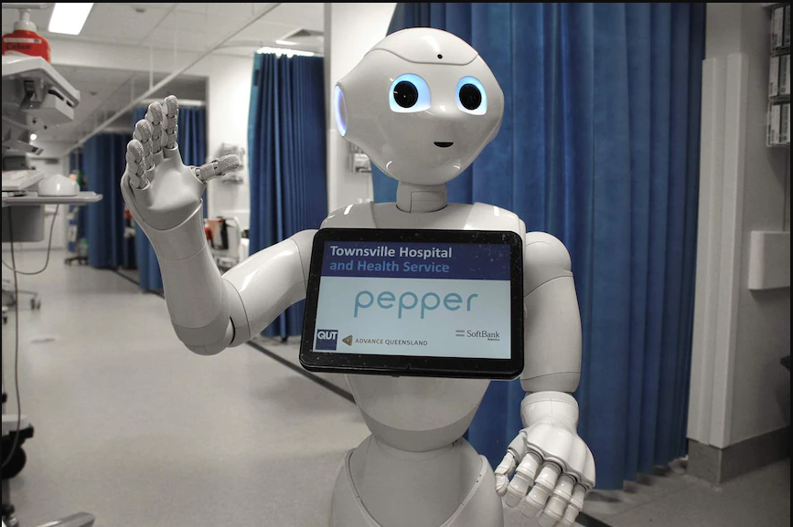
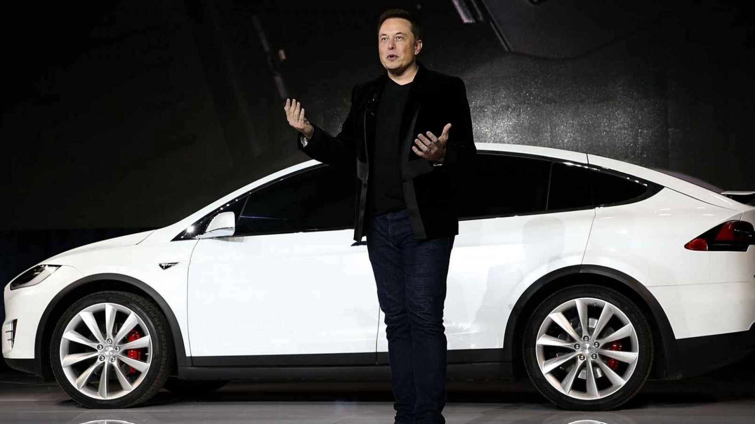
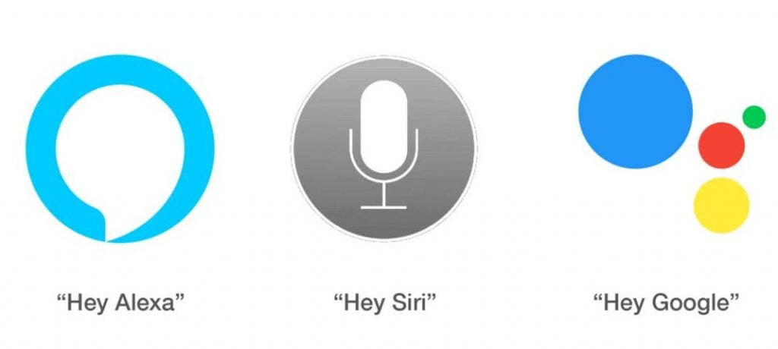

Application of Artificial Intelligence & Machine learning
Hospital Robotic
Automatic (AI) Car
Voice Assistance
Prediction using machine learning

Slide 10

Case study on AL and ML
Google search engines and shopping ads

Slide 11

Conclusion
AI is most dangerous Thing on earth
Artificial intelligence weapons
There are many incidence that scientist reported that AI can destroy humanity
In AI and machine learning field there is very good scope for career.
There are large scope in this field

Slide 12

THANK YOU!
Sandesh Gajendra Pol
Phone:
9067248106
Email:
sandeshpol268@gmail.com

